Slide 1
CST 499 Final Project Presentation by Efren Morales Jr University of Arizona Global Campus CST499 Computer Software Capstone. Instructor: Charmelia Butler Due Date: 12/8/2025
Notes:
AI-generated content may be incorrect. ---

Slide 2
Project Overview and SRS Summary intro:
This project focuses on developing a web-based Student Registration and Course Enrollment System designed to streamline the process for academic institutions. The system enables students to register, manage profiles, view semester-based courses.
The primary objectives of this project are to ensure ease of use, data security, and scalability. By leveraging modern web technologies, a relational database, and secure authentication protocols, the system provides a reliable and efficient solution for both students and administrators.
In this presentation, I will summarize the key aspects of the Software Requirements Specification (SRS), showcase the UML design model, explain the design of the landing, login, and enrollment pages, review the MySQL database structure, and discuss the PHP code implementation that powers the system.
Notes:
Introduction and Purpose, Key Aspects of the SRS Document

Slide 3

Key Aspects of the SRS Document
Functional Requirements
User registration and login
Unique user ID enforcement
Profile management
Semester-based course listing
Enrollment with capacity limits
Waitlist management
Enrollment cancellation
Waitlist promotion
Non-Functional Requirements
Focuses on system performance, security with encryption, HTTPS, and compliance with privacy regulations.
Assumptions and Dependencies
Assumes stable internet and accurate data; depends on database integration and email notification services.
Notes:
The Software Requirements Specification (SRS) document outlines the functional and non-functional requirements of the system. Key functional requirements include user registration and login, unique user ID enforcement, profile management, semester-based course listing, enrollment with capacity limits, and waitlist management. Non-functional requirements cover performance (supporting 500 concurrent users), security (SHA-256 encryption, HTTPS protocols), and compliance with data privacy regulations such as FERPA and GDPR. Assumptions include stable internet access and accurate course data provided by the institution. Dependencies involve integration with a relational database and email service for notifications. These elements ensure that the system is robust, secure, and scalable.

Slide 4

System Design and UML Model
Notes:
UML Design Model Overview

Slide 5
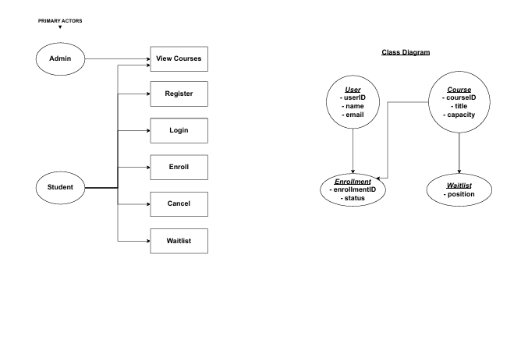
UML Design Model Overview
Use Case Diagrams
Use case diagrams depict actors like students and administrators interacting with system functionalities such as login and enrollment.
Class Diagrams
Class diagrams show relationships between entities like User, Course, Enrollment, and Waitlist to ensure modularity.
Blueprint for Development
The UML model guides implementation and facilitates clear communication among developers and stakeholders.
Notes:
The UML design model provides a visual representation of the system's structure and interactions. It includes use case diagrams highlighting actors such as students and administrators, and their interactions with key functionalities like registration, login, course viewing, enrollment, and waitlist management. Class diagrams illustrate the relationships between entities such as User, Course, Enrollment, and Waitlist, ensuring modularity and scalability. The UML model serves as a blueprint for development, facilitating clear communication among stakeholders and guiding the implementation process.

Slide 6
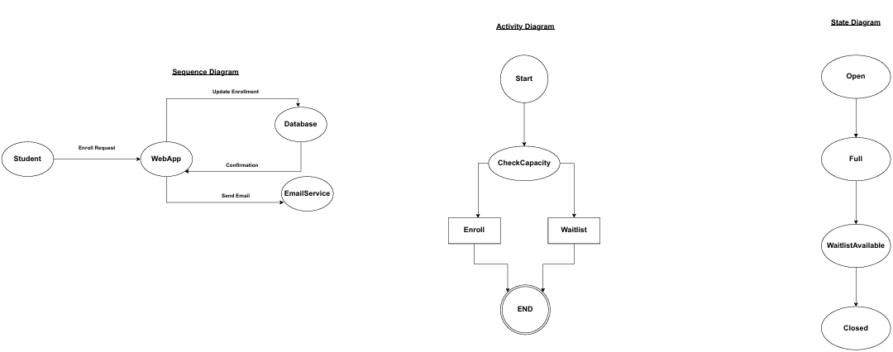
UML Design Overview Continued..
Sequence Diagram The sequence diagram illustrates the interaction between system components and users over time. It shows how a student initiates actions such as registration, login, and course enrollment, and how the system responds by validating credentials, updating the database, and sending notifications. This diagram emphasizes the chronological order of events and the flow of messages between objects.
Activity Diagram The activity diagram represents the workflow of the registration and enrollment process. It highlights decision points, such as whether a course has available seats or if the user needs to join a waitlist. This diagram provides a clear view of the system’s logic, including parallel processes like sending email confirmations while updating enrollment records.
State Diagram The state diagram focuses on the different states of a student’s enrollment status. For example, a student can transition from “Not Enrolled” to “Enrolled” or “Waitlisted” based on course capacity. It also shows how external triggers, such as an administrator increasing course capacity, can change a student’s state from “Waitlisted” to “Enrolled.” This diagram is essential for understanding how the system manages dynamic changes in enrollment.

Slide 7

User Interface Design
Notes:
Landing, Login, and Enrollment Pages

Slide 8
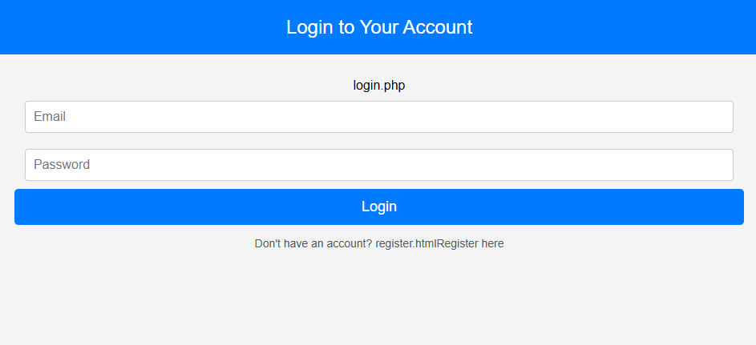
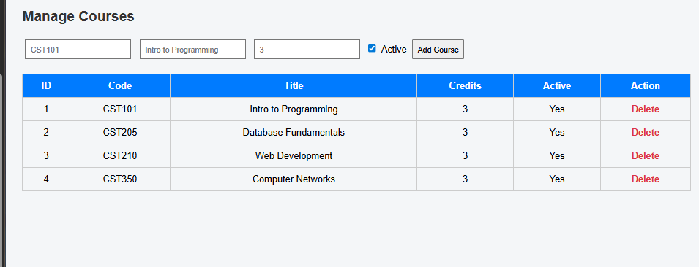
Login and Enrollment Pages
Secure Login Features
Login page uses encrypted credentials, multi-factor authentication, and error handling to secure user access.
Enrollment Page Functionality
Displays semester course listings, enforces capacity, offers waitlists, and provides real-time notifications for enrollment.
Notes:
The landing page is designed to provide intuitive navigation, featuring menus, search bars, and quick access to registration and login options. It adheres to accessibility standards (WCAG 2.1) and ensures responsiveness across devices. The login page incorporates secure authentication mechanisms, including encrypted credentials and optional multi-factor authentication for administrators. Error handling is implemented to guide users through credential issues. The enrollment page displays semester-based course listings, enforces capacity limits, and offers waitlist functionality when courses are full. Real-time updates and notifications enhance user experience, ensuring transparency and efficiency in course registration.

Slide 9

Landing Page Continued....
Purpose: Serves as the primary entry point for users, providing quick access to core features.
Key Features:
Personalized Dashboard: Displays upcoming courses, notifications, and status updates.
Responsive Design: Optimized for desktop and mobile devices.
Accessibility: WCAG-compliant for inclusive user experience.
Goal: Deliver an intuitive, welcoming interface that enhances usability and engagement.

Slide 10

Database and Backend Development
Notes:
MySQL Database and Class Registration

Slide 11
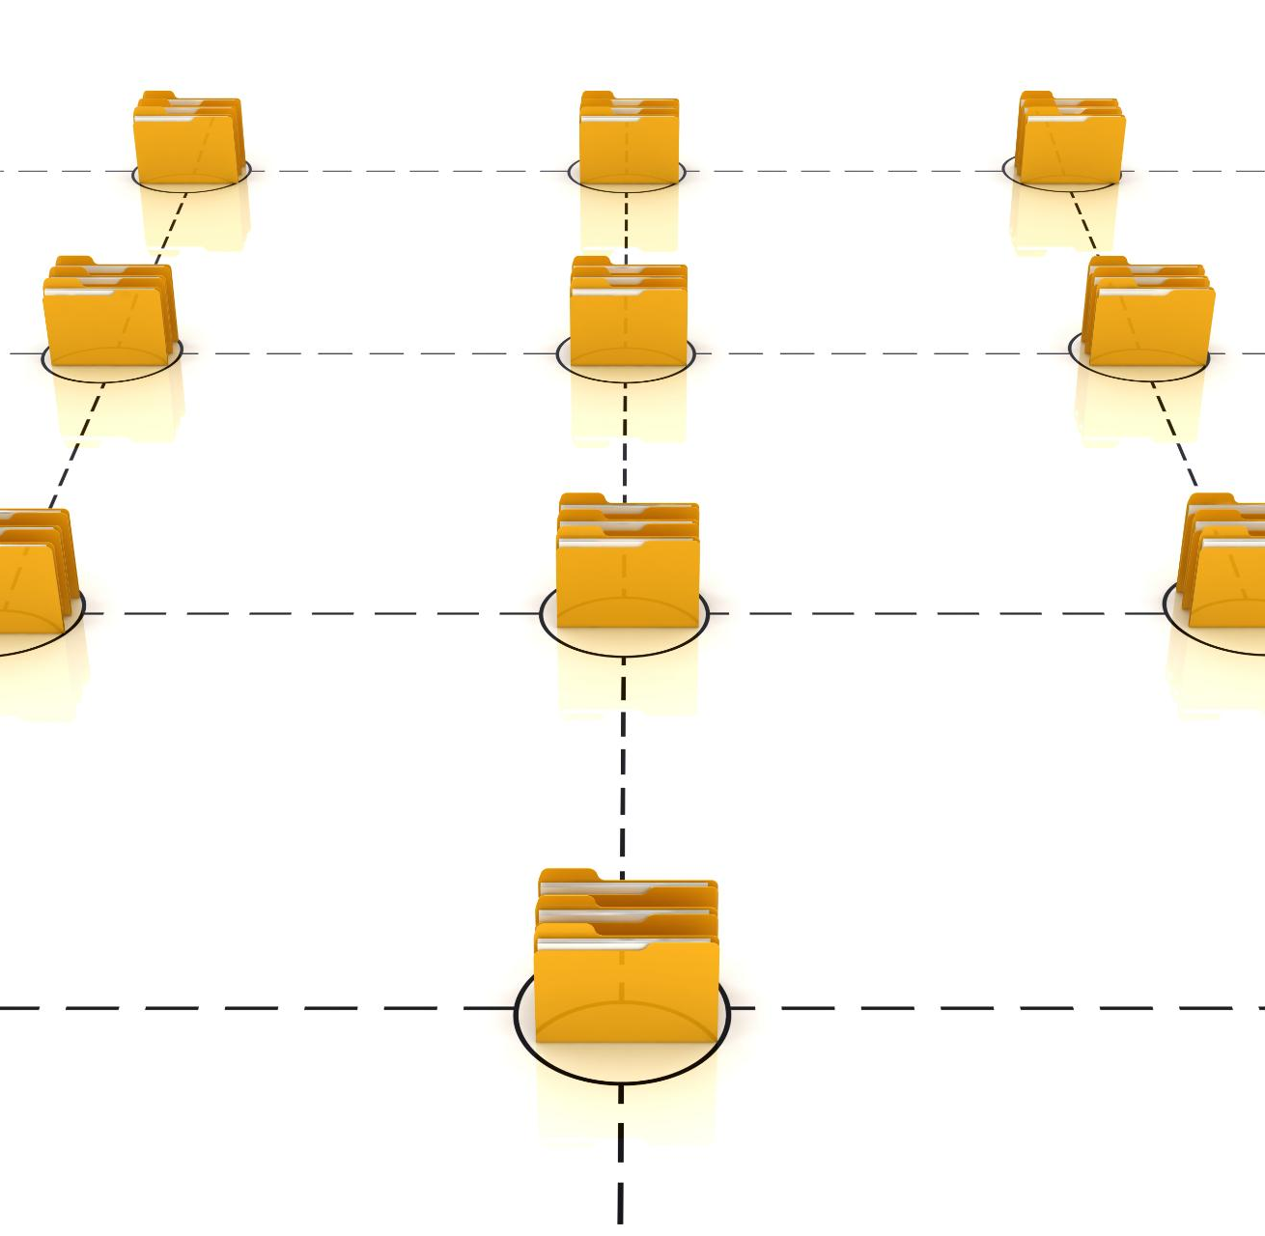
MySQL Database and Class Registration
MySQL Database Structure
The database contains tables for Users, Courses, Enrollment, and Waitlist, linked to maintain data integrity.
ACID Transaction Properties
ACID properties are enforced to ensure reliable and consistent transactions within the database system.
Class Registration Workflow
Workflow validates user credentials, updates enrollment, and manages waitlists efficiently in real time.
Notes:
The system utilizes a MySQL relational database to store user profiles, course details, enrollment records, and waitlist data. The database schema includes tables for Users, Courses, Enrollment, and Waitlist, with relationships ensuring data integrity and consistency. ACID properties are maintained to guarantee reliable transactions. The class registration workflow involves validating user credentials, updating enrollment status, and managing waitlists. Integration with the database ensures seamless data flow from user actions to backend processes, supporting real-time updates and notifications.

Slide 12

Challenges, Resolutions, and Conclusion
Notes:
Challenges and Resolutions, Conclusion and Future Enhancements

Slide 13

Challenges and Resolutions
Security Challenges
Multi-factor authentication decisions ensured robust security against unauthorized access.
Performance Optimization
Load testing improved system performance to handle many concurrent users efficiently.
Regulatory Compliance
Compliance with data privacy laws like FERPA and GDPR ensured legal and ethical standards.
Technical Solutions
Asynchronous communication and HTTPS protocols addressed real-time updates and secure communication.
Notes:
Several challenges were encountered during development, including decisions on multi-factor authentication, performance optimization for concurrent users, and compliance with data privacy regulations. These issues were resolved through stakeholder consultations, load testing, and adherence to legal standards such as FERPA and GDPR. Technical challenges related to real-time updates and secure communication were addressed by implementing asynchronous communication methods and HTTPS protocols. These resolutions ensured that the system met its functional and non-functional requirements effectively.

Slide 14
Conclusion and Future Enhancements
Project Success
The system delivers robust functionality with secure, scalable architecture meeting institutional needs effectively.
User Experience Improvement
The system enhances user experience and operational efficiency through streamlined course enrollment processes.
Future Enhancements
Potential improvements include SMS notifications, mobile app development, and advanced analytics for better academic insights.
Notes:
The project successfully delivered a comprehensive student registration and course enrollment system that meets institutional needs. It combines robust functionality with secure and scalable architecture, enhancing user experience and operational efficiency. Future enhancements may include SMS notifications, mobile application development, and advanced analytics for enrollment trends. These improvements will further increase accessibility and provide valuable insights for academic planning.

Slide 15
References
Beck, K., & Andres, C. (2021). Extreme programming explained: Embrace change (3rd ed.). Addison-Wesley Professional.
IEEE Standards Association. (1998). IEEE recommended practice for software requirements specifications (IEEE Std 830-1998). IEEE.
Lagman, R., Grefaldo, J., & Sarmiento, M. (2024). Secure user registration systems for web applications. Journal of Web Development, 12(3), 45–58.
Project Management Institute. (2017). Agile practice guide. Project Management Institute.
Shao, Y., Ieong, S., Levine, J., Stronach, M., & Fan, X. (2022). Optimizing course enrollment systems for higher education institutions. International Journal of Educational Technology, 18(2), 101–115.
University of Arizona Global Campus. (2025). Vision and scope document for student registration system. Internal document.
University of Arizona Global Campus. (2025). Use case specification for registration and enrollment. Internal document.

